Slide 1
Chapter 7 – Data augmentation
Artificial Intelligence

Slide 2
Back to work!
As said before, this slide is available as a notebook.
After that we’ll use PyCaret
Give it some data
PyCaret creates a bunch of models for us
We check the parameters and decide which we want to use
But first we need to install PyCaret, which is tricky

Slide 3

Get a domain expert
Do you have the data that you need to try to address this problem?
Is your data representative?
Notes:
You now know about the elements of an ML dataset. Recall a previous question: What data do you need to train your model to reach the intended output, and subsequently, your intended business outcome? This example depicts a stage in the ML pipeline when it’s vital to get domain expertise to help you answer this question. With domain knowledge, you can begin to determine the features and target data that your model needs to make accurate predictions.
Your data should be representative of the data that you are going to have when you use the model to make a prediction. For example, if you want to predict credit card fraud, you must collect both positive data (fraudulent transactions) and negative data (non-fraudulent transactions). The ML algorithm must have both types of data so that it can find patterns that distinguish between the two types. For example, suppose that the average amount of fraudulent transactions is actually 3 percent. However, your training dataset includes only a small fraction of fraudulent observations, say 0.4 percent. In this scenario, it might be difficult for your model to correctly learn patterns for fraudulent transactions that it might encounter in production.

Slide 4
Problems in data
The data you get will have issues
Not made available
Wrong format
Datetimes (not a real problem, but annoying)
Contains outliers
Ordinal and nominal (important to figure out)
Contains missing values
Has bias
Notes:
Not made available: a student last year’s internship was “scrape all the price data for holiday parks, so our client can use this data to better position themselves in the market.” Very nice dataset by the way.
Wrong format: Feature engineering
Datetimes: https://datagy.io/pandas-datetime/

Slide 5

3.2 - Errors in data.md
There can be many errors or annoyances in data
They’re explained in in the markdown-file in on github
The full story
But also on the following slides…
The abbreviated version

Slide 6
Outliers
Definition: Outliers are data points that significantly deviate from the rest of the dataset.
Identification: Techniques include visual inspection (scatter plots, box plots), statistical methods (z-score), and machine learning algorithms (isolation forests).
Impact: Outliers can distort statistical analyses and affect summary statistics and regression models.
Handling: Strategies include removing outliers, data transformation, winsorization, robust statistics, and creating separate models.

Slide 7
Categorical Data
Definition: Categorical data represents distinct groups or categories, divided into nominal and ordinal data.
Nominal Data: Categories without inherent order (e.g., gender, hair color).
Ordinal Data: Categories with a specific order (e.g., satisfaction ratings).
One-Hot Encoding: Technique to represent categorical variables as binary vectors for machine learning.

Slide 8
Missing Values
Identification: Use DataFrame.info() in pandas to find missing values.
Handling: Strategies include removing rows/columns, imputation (mean, median, regression, KNN), special value imputation, and creating indicator variables.

Slide 9
Bias
Types of Bias:
Sampling Bias: Non-representative sample.
Selection Bias: Influenced selection of data points.
Measurement Bias: Errors in measurement.
Reporting Bias: Systematic difference in reporting.
Confirmation Bias: Selective search for confirming information.
Algorithmic Bias: Discrimination in machine learning models.
Survivor Bias: Focus on surviving data points.
Snoop Bias: Test data influencing training process.
Mitigation: Random sampling, rigorous study designs, careful measurement, transparency, and regular bias assessments.

Slide 10


Scaling
Scaling: adjust range of data to fit between 0 and 1 (or something similar)
Min-max scaling:
Standarization:
Will provide you with data that is easier for algorithms to compare
Length in meters (between 1.5 and 2) and shoe size (35-45)

Slide 11
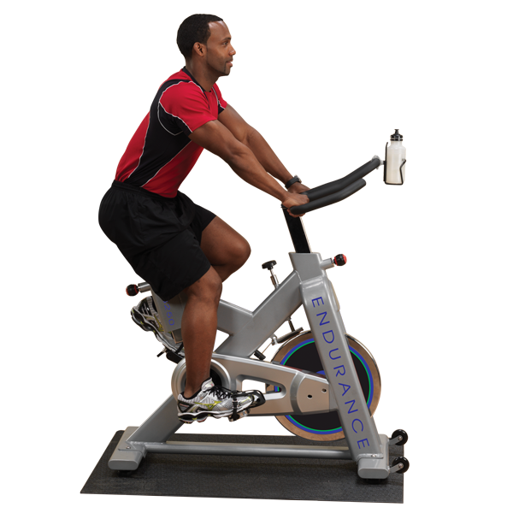
More exercises!
3.1, bike-highways (on grouping data)
3.2, Bias
3.3, One hot encoding
3.4, Missing values

